Slide 1
WELCOME
TO
RAJASTHAN
(India’s Paradise)
A Project By – TEAM OAK
Jaanvi Juneja
Anshul Sharma
Abid Ahmad
Shruti Mandaokar

Slide 2
PROBLEMS IN RAJASTHAN
Rajasthan, a state known for its exotic beauty and culture has been a major source of attraction since past centuries. However, less economic growth of the state is one the major reasons why Rajasthan has not been able to flourish much, in spite of having eye capturing assets.
Tourism is one of the major parts of Rajasthan's economic growth. However, tourists still lack knowledge about special attractions. There exists no proper availability and accessibility of handicrafts, handlooms and other famous products.
Communication gap still prevails between the vendors and the tourists, wherein the vendors charge more than the standardized rates. This is one of the major reasons why tourists get disinterested which, in turn, lessens the economy of the state.
There is no official app interfaced with the Ministry of Rajasthan which affects smooth functioning for both tourists and government.
It is the need of the hour to remove the prevailing problems.

Slide 3
SOLUTIONS
Our mobile application improves communication between the vendors and the tourists, by displaying the products of the registered local vendor at a fixed original price.
It enhances the availability and accessibility of products in which user can choose any city within Rajasthan and access details like history, location, advantages, the actual price of the product without the interference of any third party. The user can also mark his favorite product for easy access in future.
Ministry Login: Ministry of Rajasthan has access to upload the information about a particular product and can add vendor's information.
Vendor Registration: Any salesman of Rajasthan can submit his details to ministry.
Customized Tour Plan: The app will design a personal customized tour plan accordingly to user's budget and by knowing for how many days he's in the city.
Tour Guide: The app will let tour guide register their info and if the user wants to use a tour guide he will be assigned to the user at a fixed price.

Slide 4
Working in Android Studio
WORKING
Search Module
Ministry Module
Vendor Module
Bookmarking of Products
Tourist Module
Location Finding Module

Slide 5
Work Plan
Functional Design – Functional design and user interface design for android app and web app will be charted out.
Data Collection and Analyze – Database will be created/modified and any additional data will be included within the tables.
Web services – Python flask backend will be used to provide interactivity with the database on the server.
Working In Android Studio
Design – Layout for all the activities will be designed in a user friendly manner and tested for good user experience.
Search module – Write code for search module for searching the product in particular or all Rajasthan and view its details.
Ministry module – Write code for ministry module so that Authorized personnel can login and check vendor details, feedback, vendor remarks.
Vendor module – Write code for vendor module so that Product Vendors/sellers can submit their details to the ministry.
Bookmarking of product – Write code for bookmark module to store the detail of liked product in local SQLite Database.

Slide 6
WORK PLAN
Sharing of product details – Write a code to send the detail of product to family and friends via messages and social media.
Tourist module – Write code for tourist module so that tour guides can submit their details to the ministry.
Location Founding Module – Write a code for finding famous location for the user using google maps navigations.
Easy sharing of app and products information with others using Instagram,Facebook and other social sites which will give publicity to the given product and in-turn increase the revenue of the vendor.
App provides location-based services using which user can view nearby places in the city based on his/her current location and GPS navigation to help the user to easily visit that place.
Testing the app with different devices and versions.
Upload app on Play Store.
Upload database on Server.

Slide 7
OUR TECH STACK
Core Java- Java is general-purpose programming language that is concurrent, class-based, object-oriented, and let application developers “write once, run anywhere” (platform independent).
Android Studio-Android Studio is the official integrated development environment (IDE) for the Android platform development. Android Studio provides the fastest tools for building apps on every type of Android device.
Python Flask Backend – We’ll be using Flask, a python web application framework to create our application, with Firebase as the back end.
Online database server- MySql/SQLlite, Firebase
Google Map API – We’re using Google Map API in our android project to make app convenient to use.

Slide 8
PLANNING TO USE
We want to make our app convenient as much as possible. So, we’re planning to use :
Zomato API : for Restaurants
Booking.com API : for Hotel Bookings
Uber/Ola API : for Travelling
Aadhar API : for automatically authenticating Aadhar Numbers
We’re taking good care of data. For that, we’re using Firebase Database, which is easily scalable.

Slide 9
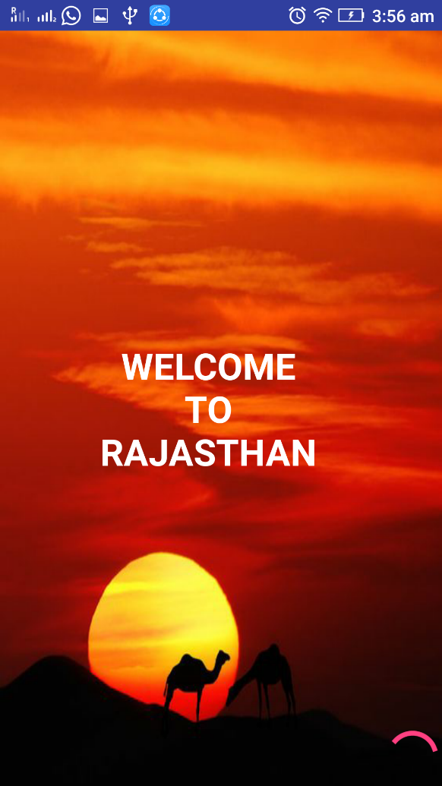
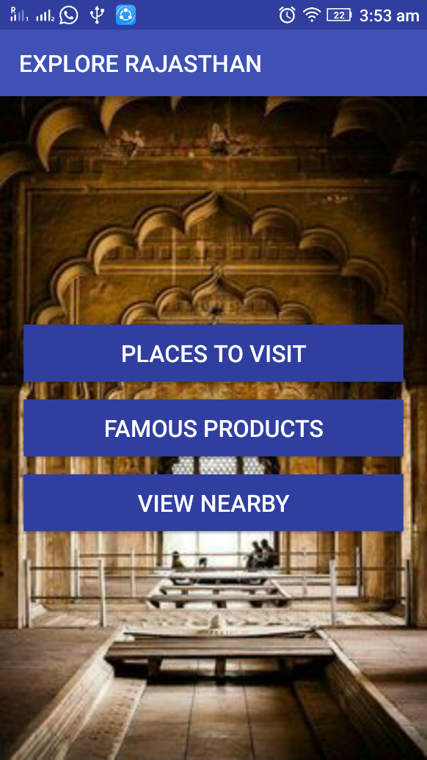
IMPLEMENTATION OF APP
Splash Screen
Navigation Screen

Slide 10
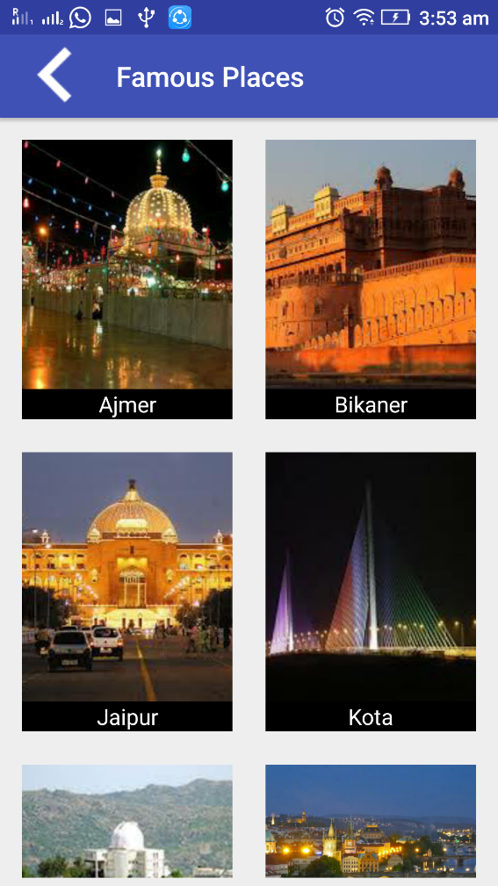
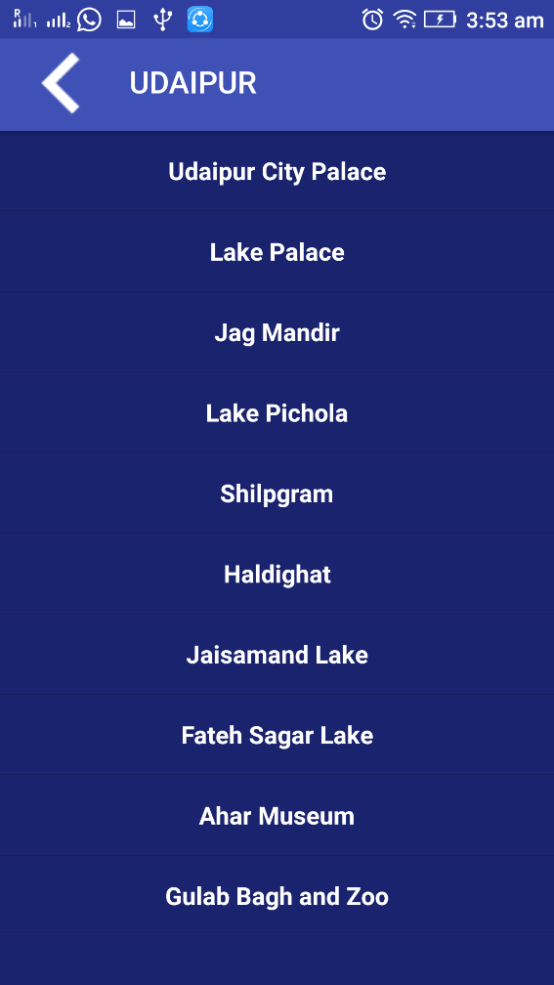
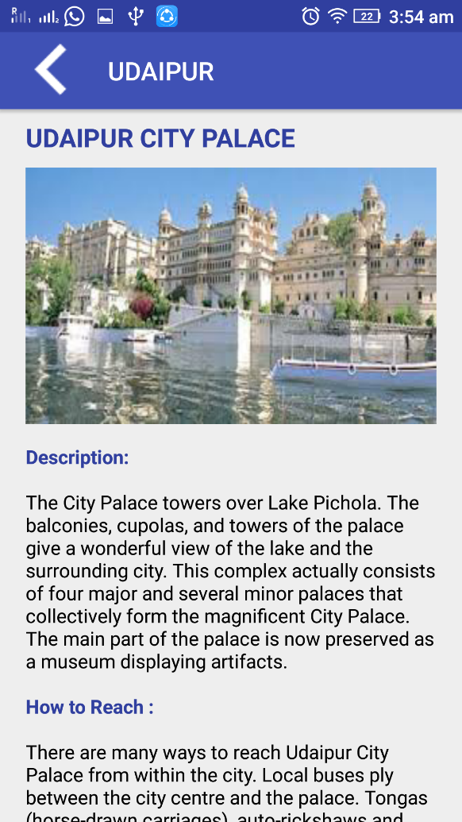
IMPLEMENTATION OF APP
Places to Visit
Tourist Spots in Udaipur
Udaipur City Palace

Slide 11
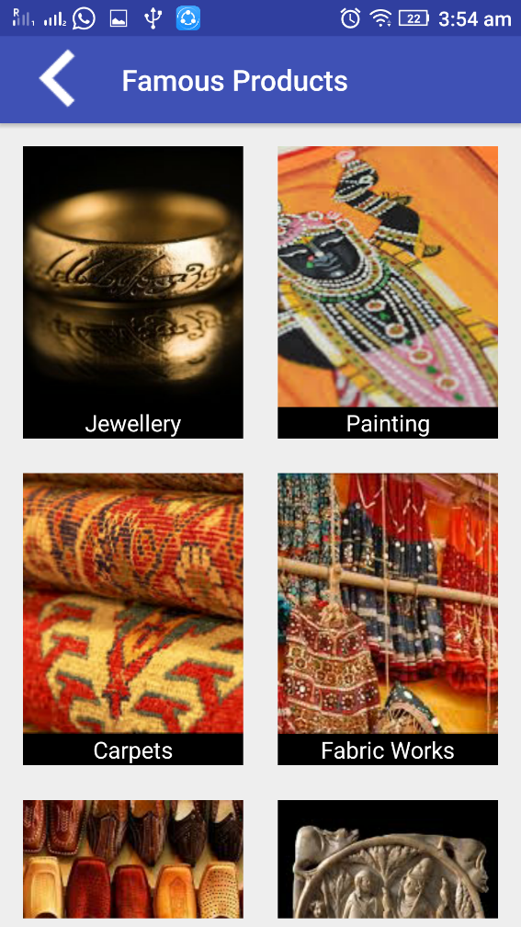
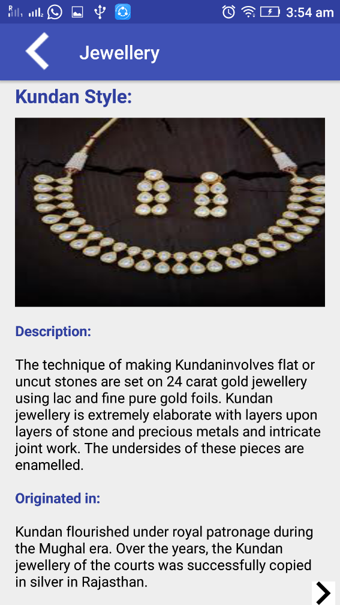
IMPLEMENTATION OF APP
Famous Products
Kundan Style Jewellery

Slide 12
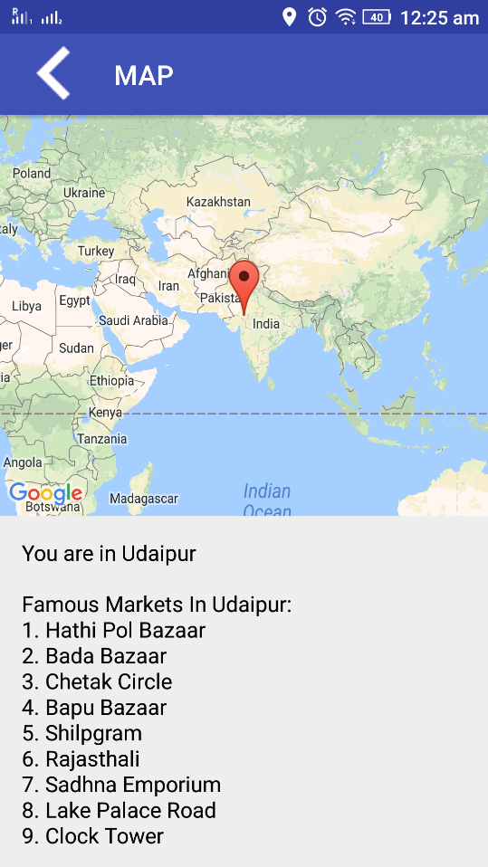
IMPLEMENTATION OF APP
App provides location-based services using which user can view nearby places in the city based on his/her current location and GPS navigation to help the user to easily visit that place.
View Nearby

Slide 13
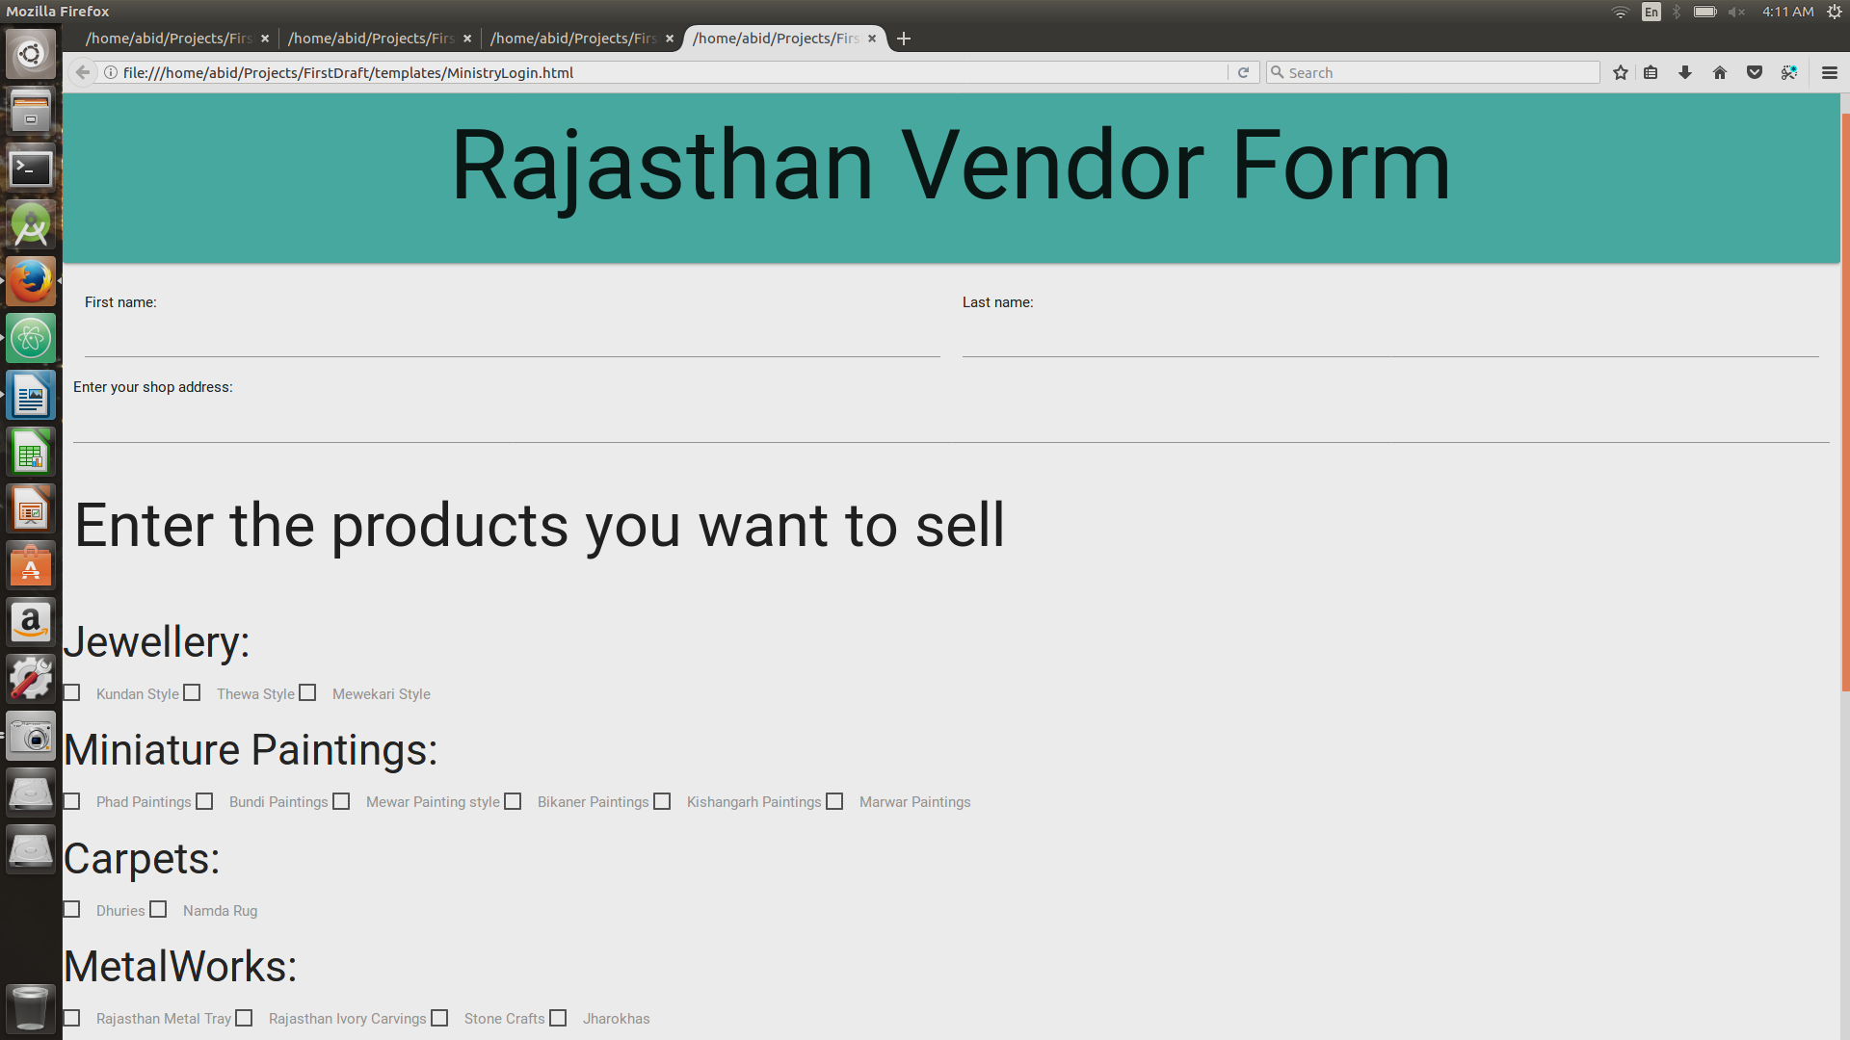
RAJASTHAN WEB PORTAL
Vendor Form: The vendor submits his details about his products in this form which is then governed by ministry of Rajasthan.

Slide 14
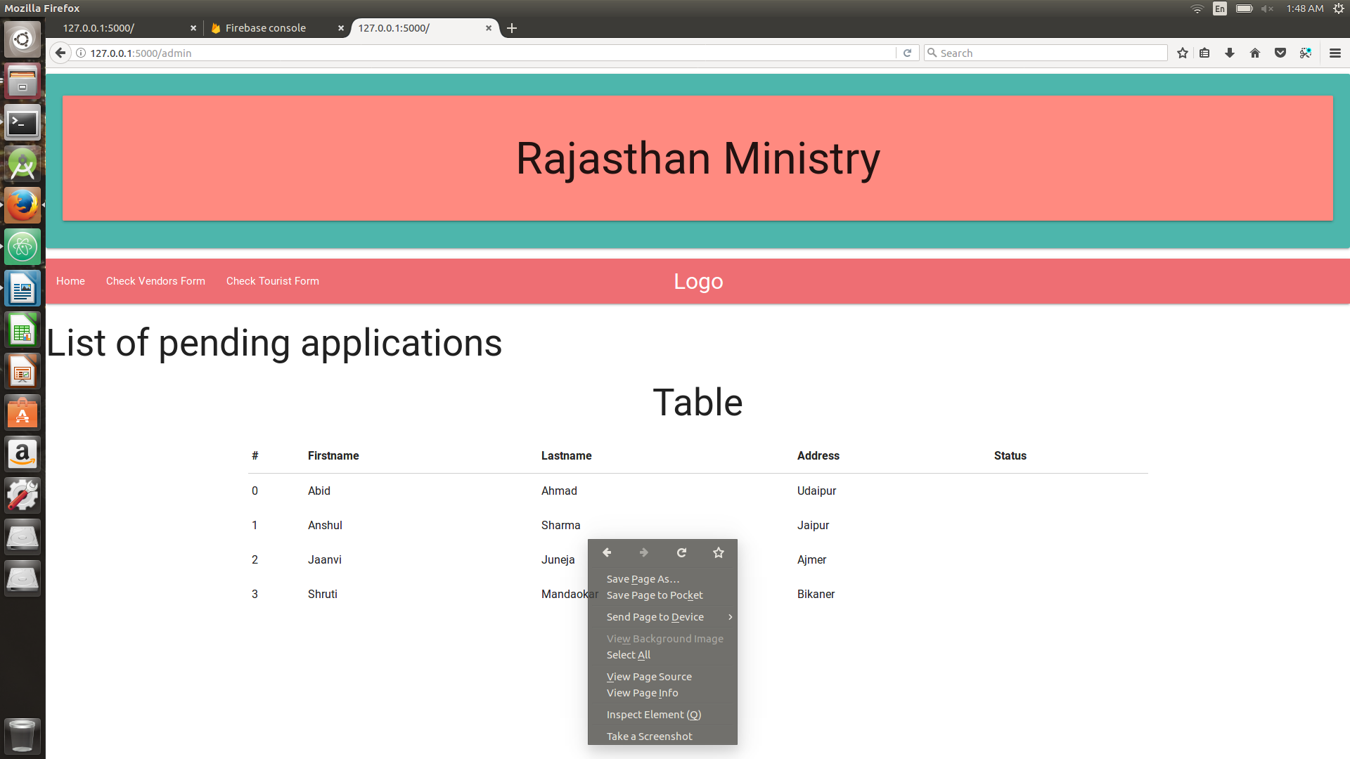
RAJASTHAN WEB PORTAL
Status Accepting Webpage : The vendor submits his details which gets stored in the database which gets retrieved accordingly in the portal.

Slide 15
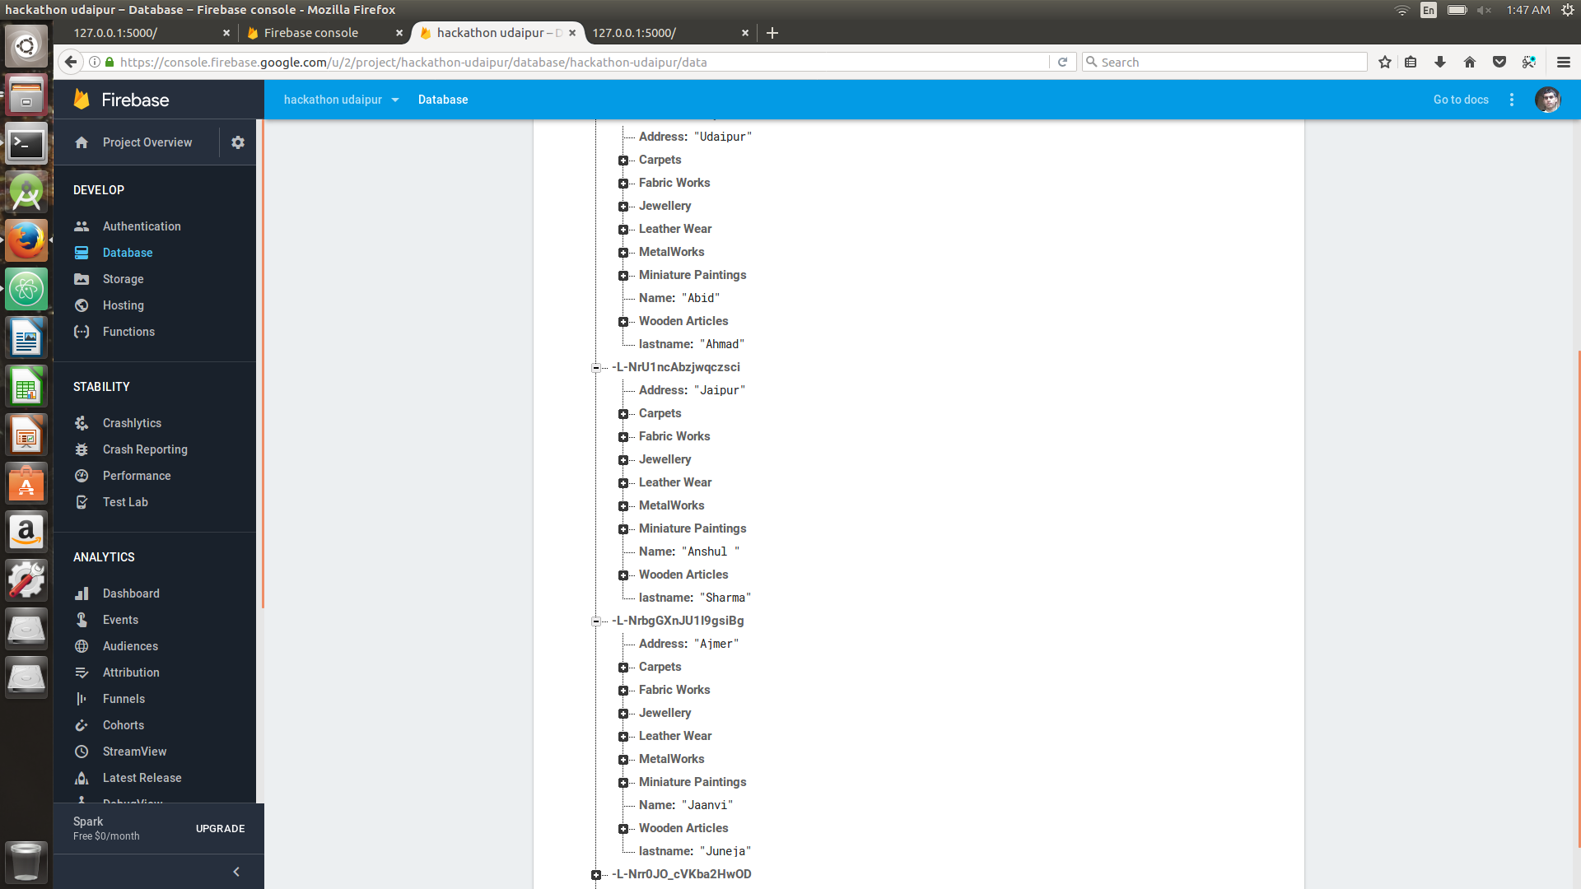
RAJASTHAN WEB PORTAL
Firebase Database (Online): This is a snapshot of all the data submitted by vendor and the list of all admin users in database.

Slide 16
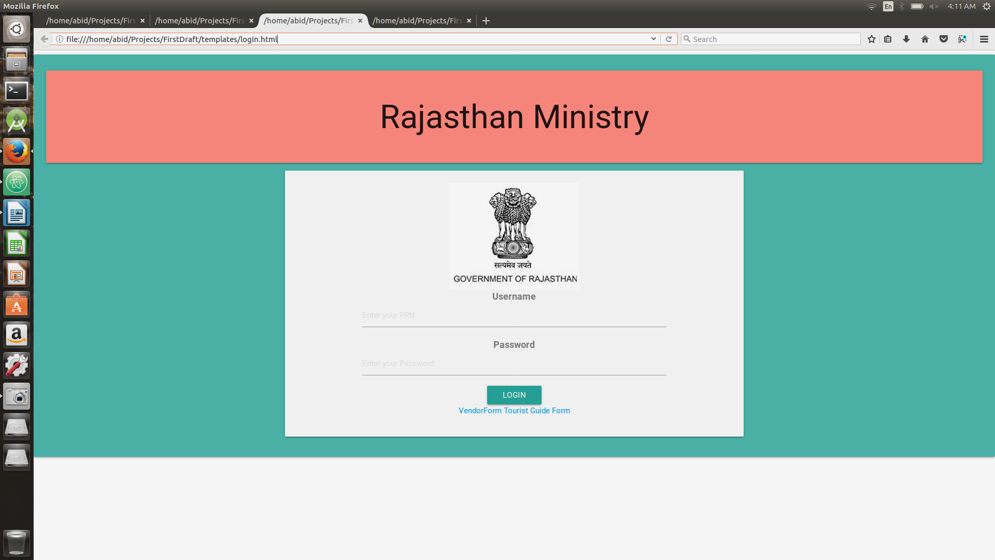
RAJASTHAN WEB PORTAL
Ministry Login: Ministry of Rajasthan can login in this portal and manage all the details.

Slide 17
THANK YOU

